Slide 1
Audio Tracking
Group B-2

Slide 2

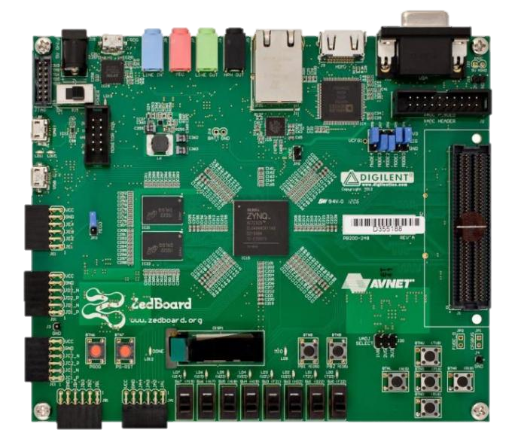
Big Picture
Detect the positon of a specific sound source.
Source could be a beep or human voice.

Slide 3
Challanges
Heard audio is a problem on these boards
Timing is everything. We will be trying to detect the difference in sound only inches apart. We may need to move the microphones further apart.
Orientation of the microphones changes how the system works.

Slide 4

Schedule
Get data from microphones by April 13
Be able to identify our beeps from noise by April 20
Calculate distances and present it nicely by April 27
Finishing touches get done before May 5

Slide 5
Rubric
Proficiency/Performance Scale
 | Mediocre (25 pts each) | Satisfactory (50 pts each) | Outstanding (75 pts each)
Interface with Microphone | Detect that a mic is plugged in | Obtain audio data through PMOD connector | Hardware IP core interfaces with mic
Detectable Sounds | Detects a beep | Detects 2 or more beeps at the same time. The beeps will have different frequencies | Detects human voice. Can tell the difference between human voice and a beep that occurred at the same time.
Tracking | Detect which mic picks up sound first | Detect distance to source | Detect distance and angle to source
Displaying data | line by line, outputting numbers in putty | graphic display in putty | send data to the pc using UART and have a program on the PC display it nicely in graphs

